Slide 1
Managing Fiscal Risks and Debt-related Contingent Liabilities
Baba Yusuf Musa PhD
Director General
West African Institute for Financial and Economic Management
(WAIFEM)
World Bank 13th Debt Management Facility Stakeholders’ Forum
“Managing Debt in High interest Rate Environment”
June 15 – 16, 2023 | Berlin, Germany

Slide 2
Outline of the Presentation
Introduction
Definition of concept:
Fiscal Risks
Contingent Liabilities
Why Fiscal Risks Matter & sources of fiscal risk in Africa
Fiscal Risk Management Process
Fiscal Risk management in selected African Countries
Recommendation
Conclusion
Legal Framework & Fiscal Risks for Sierra Leone, Ghana, Kenya & Zimbabwe

Slide 3
Public finances of governments, businesses and individual citizens of most countries around the world today have had and are still feeling the devastating impacts and economic upheaval caused by crises that could not have been forecast few years ago. These crises ranges from the Covid-19 global pandemic, recessions, financial crises, climate change or natural disasters to inflation and energy crises stemming from the war Russian/ Ukraine war and the altered global interest rate landscape that is making lending to Low Income Countries (LICs) and debt servicing prohibitively expensive. Various governments had to take steps to shield their citizens and economies from the worst effects of these challenges which is taking place against a backdrop of high debt level, limited fiscal spaces and elevated uncertainty that we cannot predict what events may develop next year or the year after so that policy makers can structure public finances with resilience in mind.
Introduction

Slide 4
The shocks that have shaken the global economy in recent years have introduced a new normal for turbulence lifting uncertainty to exceptionally high levels, which in turn hurts economic growth and caused fiscal risks.
Introduction
Fiscal risks that may arise from a range of different sources which can be classified as follow:
Economic
Environment
Geopolitical
Technological
Note:
The Presentation focused on Fiscal Risks relating to African countries
Societal

Slide 5
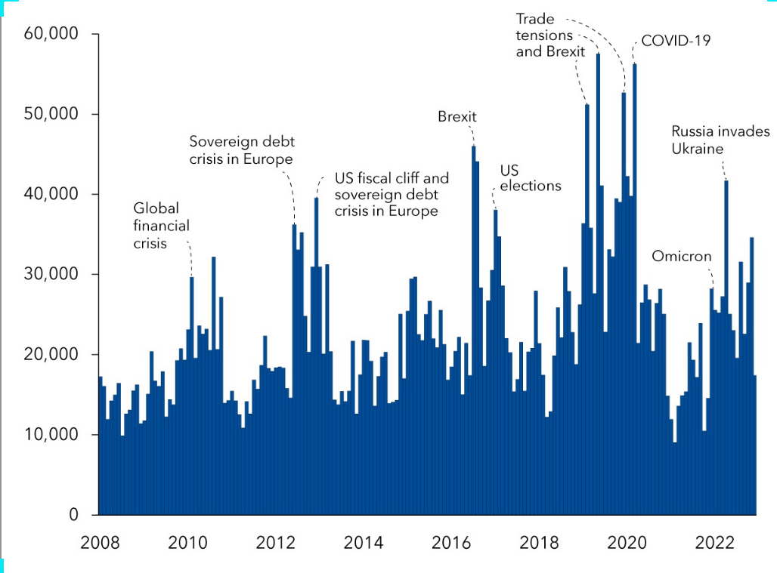
Introduction
World Uncertainty Index 2008 - 2022
(Index, GDP weighted average)
Sources: Ahir, Bloom, and Furceri (2022), Chart of the Week Jan.2023

Slide 6
What is Fiscal Risk ?

Slide 7
What is Fiscal Risk ?
Fiscal risks are deviations from fiscal outcomes expected at the time of budget formulation or other forecasts. This deviation might create significant impact on government finances and impair the capacity of governments to use fiscal policy to stabilize economic activity and support long-term growth. (World Bank 2019). Thus, Fiscal Risk Management refers to comprehensive analysis, disclosure and management of fiscal risks.
Fiscal risks are factors that may cause fiscal outcomes to deviate from expectations or forecasts. i.e. all those factors that can cause government finances to deviate from what we expect.(IMF Lesley Fisher and Amanda Sayegh 2022).
Fiscal risks refer to the uncertainty associated with the outlook in public finances and can be defined as the probability of significant differences between actual and expected fiscal performance, over the short to medium-term horizon (Kopits 2014).
This presentation focused on Fiscal Risks relating to African countries
Factors or potential shocks to government revenues, expenditures, assets, or liabilities, which are not reflected in the government’s fiscal forecasts or reports.

Slide 8
Fiscal risks what are they?
Macroeconomic shocks
Growth
Exchange rates
Interest rates
Commodity prices
Fiscal Risks
Contingent
Liabilities
Explicit/implicit
Guarantees
SOEs & PPPs
Legal claims
Tail-risk events
Pandemic
Nature &
climate disasters
Societal &
Conflicts
Technological

Slide 9
What is Contingent Liabilities ?
Contingent liabilities are obligations that do not arise unless a particular, discrete event(s) occur(s) in the future.

Slide 10
Contingent Liabilities
Debt managers and fiscal risks mangers are concerned about risks from contingent liabilities - explicit, as well as implicit contingent liabilities from debt of state-owned enterprises and subnational governments, as well as financial sector risks and natural disaster.
Explicit
Contingent Liabilities
Implicit
Contingent Liabilities
Legal or contractual financial arrangements that give rise to conditional requirements to make payments of economic value. The requirements become effective if one or more stipulated conditions arise.
Do not arise from a legal or contractual source but are recognized after a condition or event is realized.
Guarantee on PPP
Guarantee on sub-national or SOE’s Loans
Guarantee on Insurance Programme
Settlement of Investment disputes
Projected Shortfalls in Pension Schemes
Bailout of Sub-national entities, SOE’s losses and arears
Bail out of Banks & microfinance institutions
Bailout of private enterprises (Too big to fail)
Settlement of Investment disputes
Cost of recovery from Natural Disasters, Pandemic etc
Key Message
Contingent liabilities have been one of the largest sources of fiscal risk in Africa. In several cases, materialization of guarantees, failure to disclose some SOEs debt and arrears, exchange rate depreciation and lack of capacity to prepare for fiscal risk has led to large increases in public debt.

Slide 11
Why Fiscal Risks Matter

Slide 12



Why Fiscal Risks Matter
Key Message
Fiscal risks can be very costly and have huge implications for a country’s economy and public finance

Slide 13
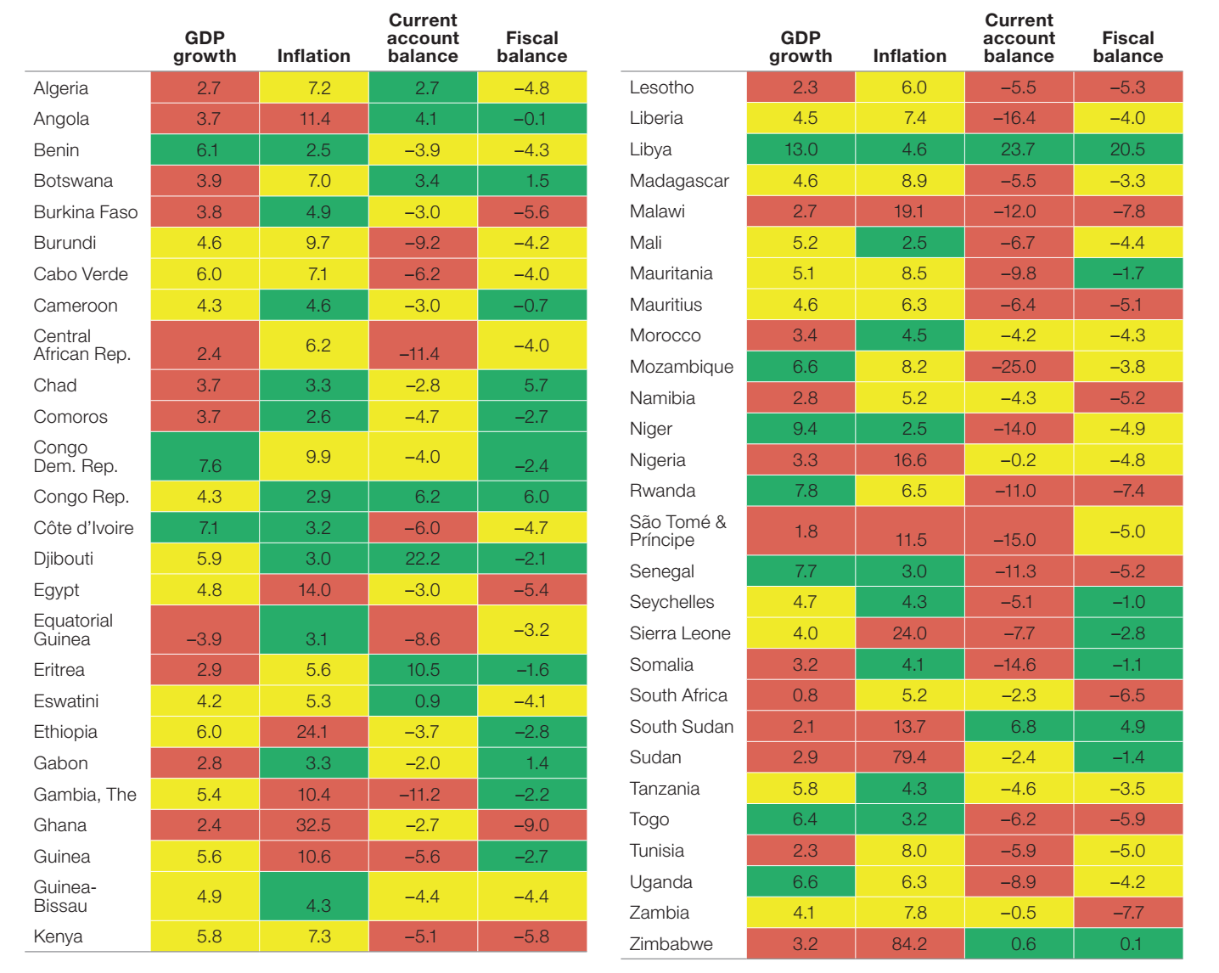
Why
Fiscal Risks Matter
Sources of Fiscal Risk: Macroeconomic Shocks
Heatmap outlook for selected key macroeconomic indicators of Africa countries, average, 2023–24
Table 1
Green for good performers, yellow for fair performers, and red for weak performers. Real GDP growth above 6 percent green, 4–6 percent yellow, and below 4 percent red. Inflation below 5 percent is green, 5–9.9 percent yellow, and above 10 percent red. Current account surplus is green, deficits below 5 percent yellow, and above
5 percent red. Fiscal surpluses and deficits below 3 percent are green, 3–5 percent yellow, and above 5 percent red.
Source: AfDB Africa Economic Outlook 2023

Slide 14
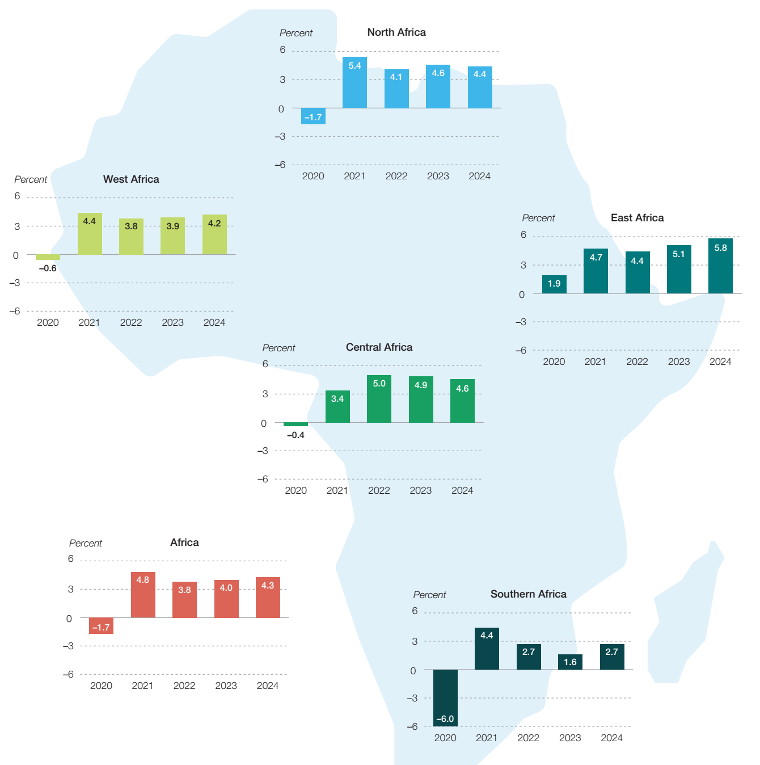
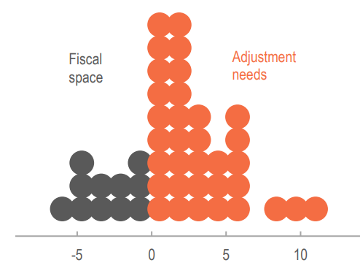
Why
Fiscal Risks Matter
Sources of Fiscal Risk African in context: Macroeconomic Shocks
Volatility in real GDP growth 2020 - 2024
Sub-Saharan Africa: Fiscal Adjustment Needed to Stabilize Debt Below 70% of GDP
Figure 1b
Figure 1a
Source: IMF Sub-Saharan Africa Regional Economic Outlook Oct 2022
Source: AfDB Africa Economic Outlook 2023

Slide 15
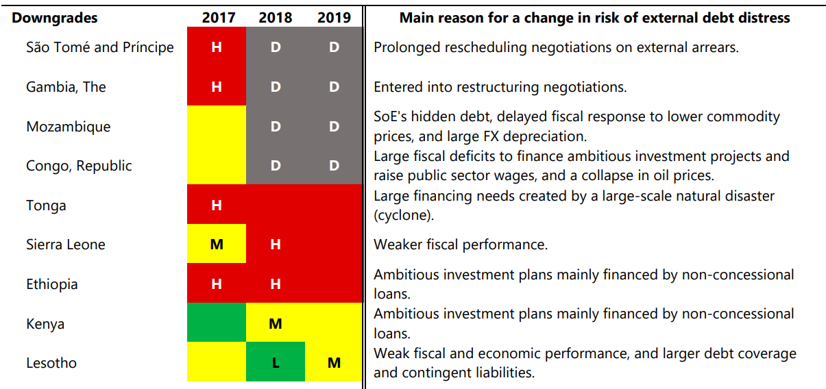


Why
Fiscal Risks Matter
Sources of Fiscal Risk: Macroeconomic Shocks
Between 2017 – 2019 fiscal risk factors accounted foabout 70% of worsening of Debt of HIPC African countries to either high risk or in debt
Changes in Risk Ratings under the LIC DSF, 2016–19
Source: IMF Policy Paper: The evolution of public debt vulnerabilities in Lower income economies. Feb 2020

Slide 16
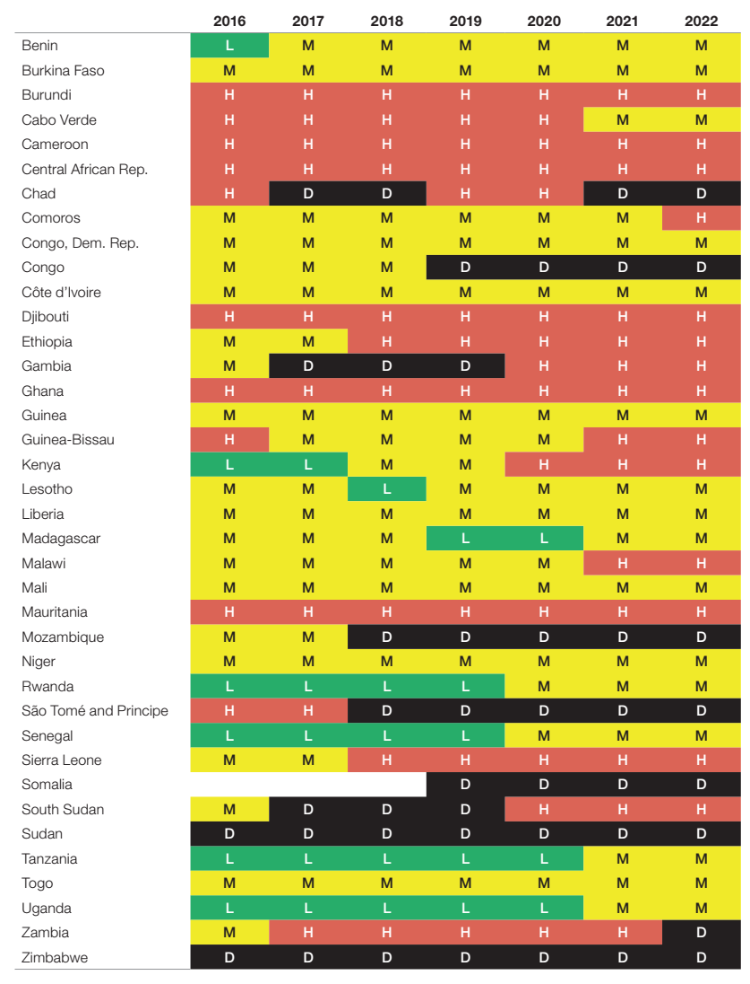

Why
Fiscal Risks Matter
External debt distress rating, 2016–22
Figure 3
Key Message
22 out of 54 countries in Africa are either at high risk of debt distress or at debt distress
Source:
AfDB Africa’s Macroeconomic Performance and Outlook - January 2023

Slide 17
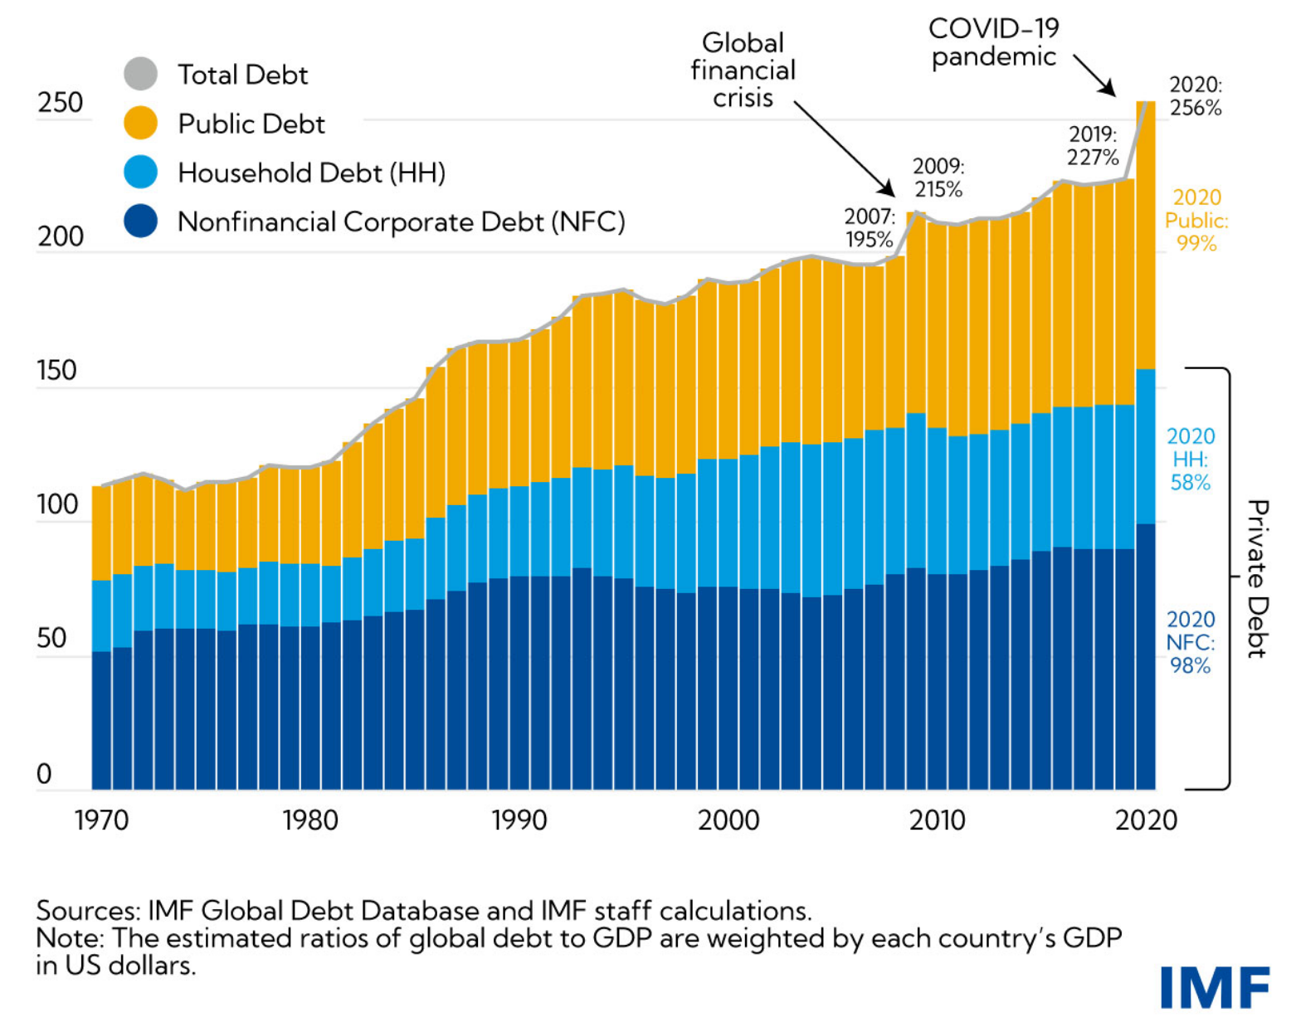
Why
Fiscal Risks Matter
Global Debt
Figure 2
Key Message
The accumulation of public debt since 2007 is largely attributable to the two major economic crises governments have faced:
(1) first the global financial crisis, and (2) then the COVID-19 pandemic

Slide 18
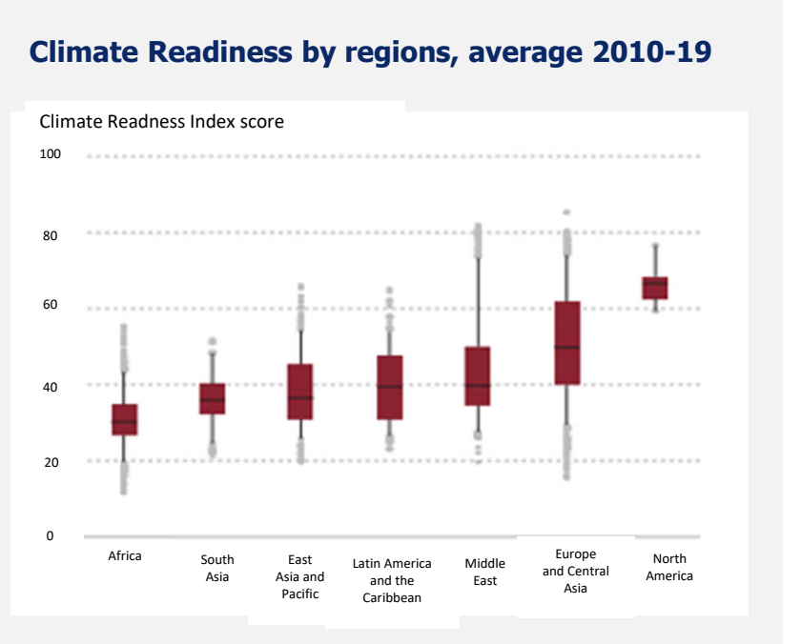
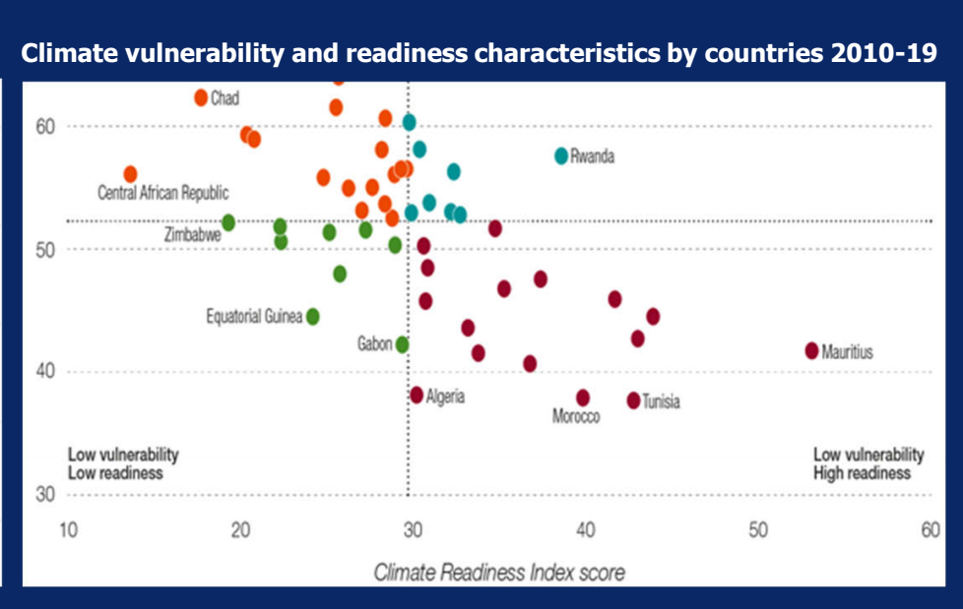
Why
Fiscal Risks Matter
Sources of Fiscal Risk: Tail-risk events
Figure 4a
Figure 4b
Key Message
Africa is the least prepared continent for climate change but among the highest receiver of impact of climate change and thus contributing to fiscal risks
Source: AfDB Africa Economic Outlook 2022: Supporting Climate Resilience and a Just Energy Transition in Africa

Slide 19
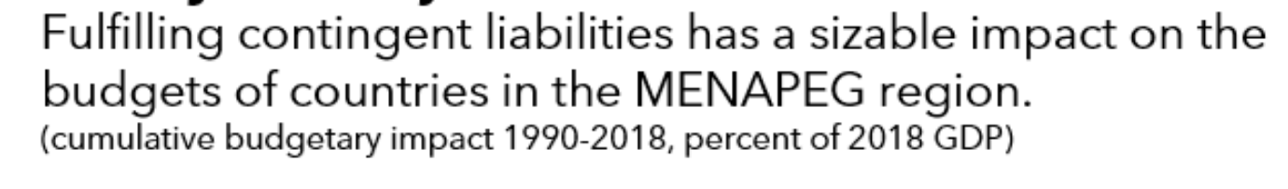
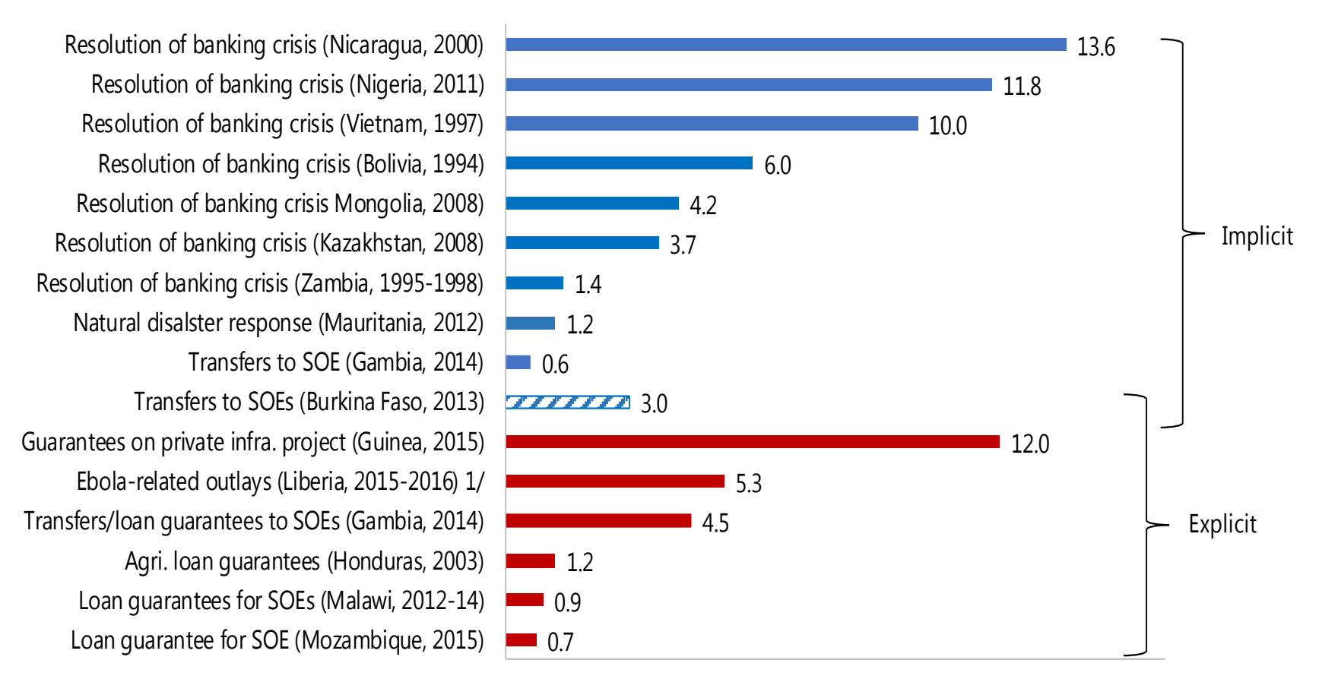
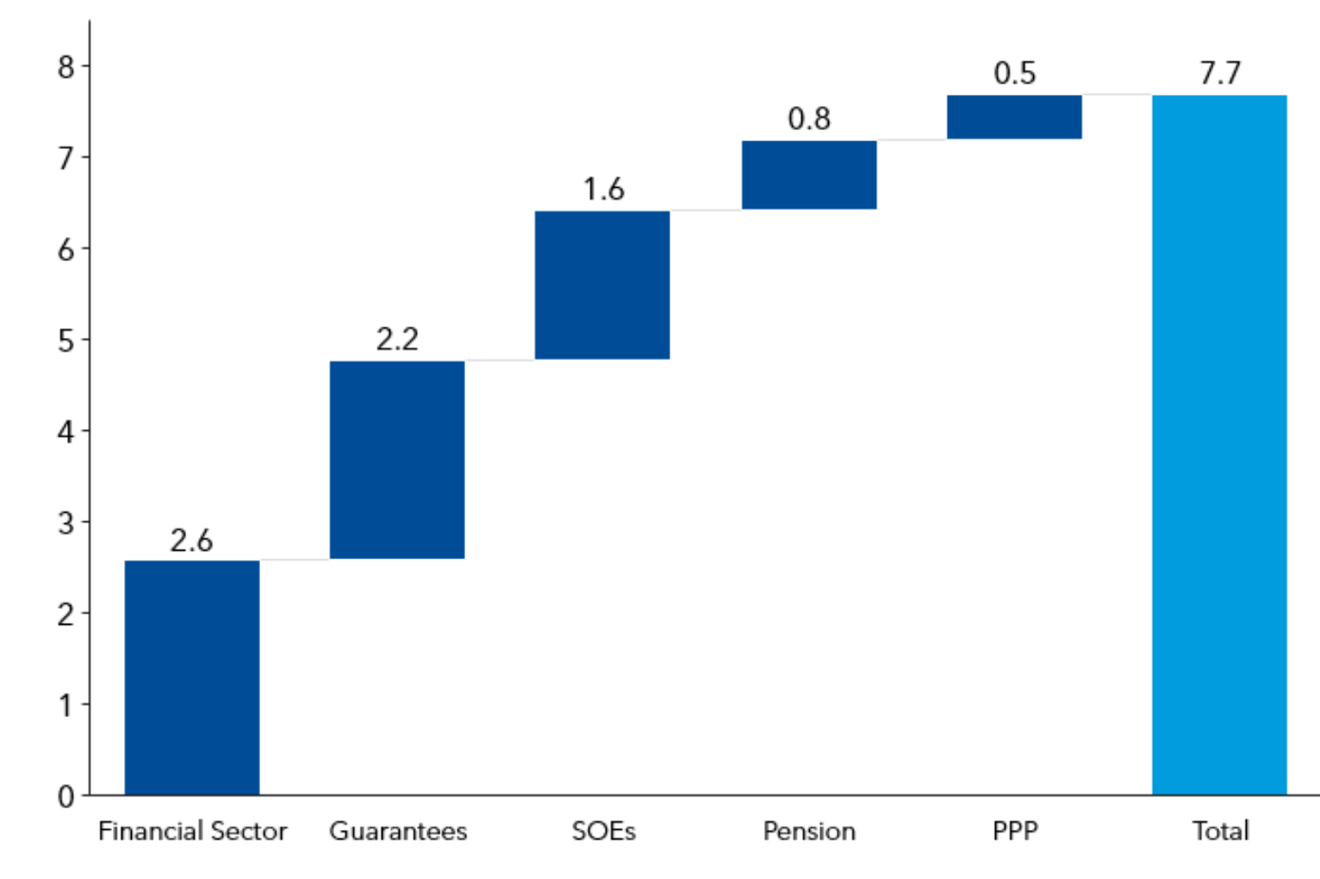
Why
Fiscal Risks Matter
Sources of Fiscal Risk: Contingent Liabilities events
Figure 5a
Materialization of Contingent Liabilities: Some Examples
(Percent of GDP)
Figure 5b
Source: Managing Fiscal Risks in Low-income Countries” : Baum, Hodge, Mineshima, Moreno Badia, and Tapsoba (2017).
Source: Antoinette M. Sayeh, et el IMF 2023

Slide 20
Framework for Fiscal Risk management

Slide 21
Fiscal Risk Management Process
Fiscal Risk Management
Step 1:
Identify and Quantify
Step 2:
Mitigate
Step 3: Provision
Step 5:
Disclose
Step 4: Accommodate Residual & create space
Figure 6a
Key Message
Fiscal risk management require that risks to the public finances are identified, analyzed, and managed and disclosed. In addition, the fiscal decision on managing fiscal risks across the public sector is effectively coordinated.

Slide 22
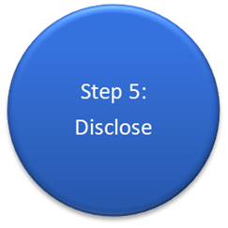
Fiscal Risk Management Process
Step 1:
Identify and Quantify
Identify risks
Step 2:
Mitigate
Cap exposure
Step 3: Provision
Expense
Step 4: Accommodate Residual
Calculate exposure and likelihood
Weigh costs and benefits of intervention
Regulate
Transfer
Budget Contingencies
Create a fiscal Buffer to absorb the risks
Figure 6b
  Account for in setting fiscal objectives

Slide 23
Fiscal Risk Management in African Countries

Slide 24
Stylized Facts on Macro-Fiscal Functions in some African Countries
Most African countries have established in their Ministry of Finance/ Planning (MoF) a department or unit in charge of macro-fiscal management functions. The department/unit undertake the following function:
        Policy analysis (including macroeconomic, fiscal, and tax policy and Identification and monitoring )
        Macroeconomic and fiscal forecasting
        Fiscal risk analysis.
        Organizational Arrangements for Macro-Fiscal Functions in some African Countries
Most countries carry out fiscal planning beyond the annual budget year. They prepare 3 – 5 year medium-term fiscal frameworks (MTEFs), with targets and strategies.
They publish Fiscal Strategy Statement Annually or every 2 to 3 years.
Table 3
One main MoF department / division performs most macro-fiscal function | Several departments perform macro-fiscal functions | MoF department(s) plus a planning/economy ministry perform macro-fiscal functions
Eritrea, Ghana, Guinea, Kenya, Lesotho, Liberia, Malawi, Mauritius, Rwanda, Senegal, Sierra Leone Tanzania, Uganda, Zimbabwe, South Africa | The Gambia, Mozambique, Namibia, Seychelles, Sudan, Zambia | Benin, Burundi, Cote d Ivoire, Ethiopia, Madagascar, Malawi, Nigeria, South Sudan Zanzibar,
The Fiscal Strategy Statement usually:
Identify sources of risk
Provide information on how risks are monitored
Analyze aggregate risks
Assess and prioritize the risks
Provide advice to Ministers
Preparing published material

Slide 25
Legal Framework for Fiscal Risk Management
(Republic of Sierra Leone)
The Public Financial Management Act, 2016 mandate the Minister of Finance to:
PFM Act mandate
- Development of government’s fiscal policy
- Monitor and management fiscal risks
Through Fiscal Strategy Statement in addition to the budget
Medium Term Budgetary Framework
Make forecasts of macroeconomic and fiscal indicators
Actual outcomes of these indicators and an explanation of the reasons for significant differences between them, if any
Fiscal risk statement; (j) ceilings on total expenditures details for 3 years
The act requires that Fiscal Strategy Statement laid before Parliament
Minister shall identify and analyze risks which may have a material effect on the fiscal outlook.
(a) results of sensitivity analysis based on different assumptions in respect of main macroeconomic and fiscal indicators;
(b) information and analysis of existing exposures of entities included in the central government to contingent liabilities, including those arising from guarantees, losses on pending court cases, and any other sources, and to loans and advances;
(c) any other information as may be deemed appropriate by the Minister.

Slide 26
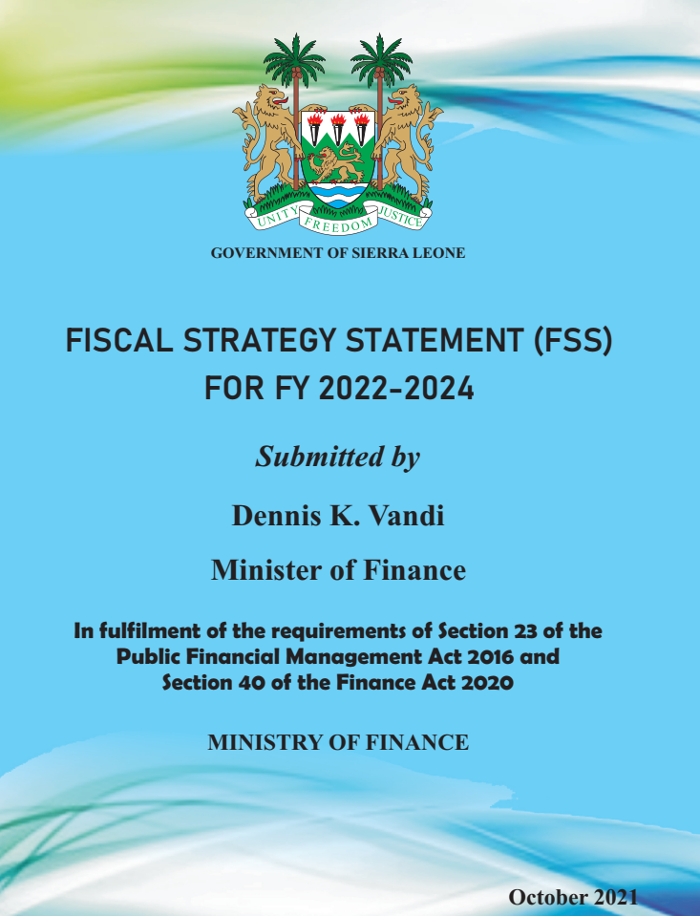
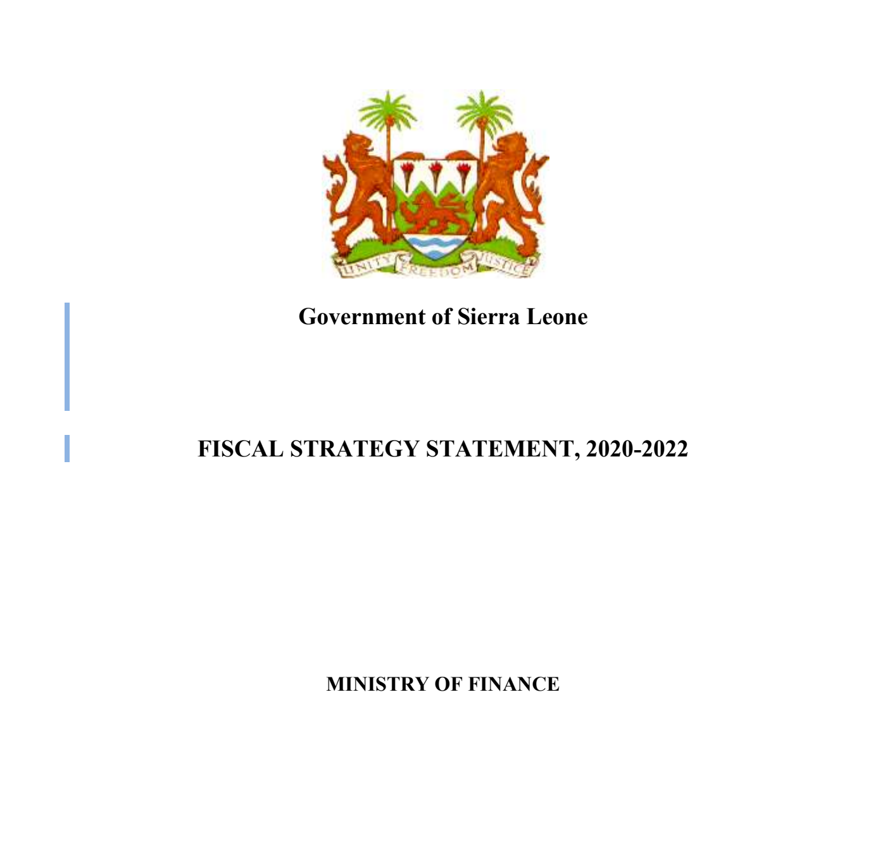
Framework for Fiscal Risk Management (Republic of Sierra Leone)
Currently Sierra Leone:
Publish fiscal strategy Statement which contain a section on fiscal risks and contingent liabilities
Publish financial performance of SOEs look at the solvency, liquidity and efficiency ownership and governance policy
Developed a Disaster risk financing and mitigation strategy
Fiscal Risks that are being analyzed and published in Sierra Leone
Fiscal risk statement
Macroeconomic risks
Volatility in GDP growth
Inflation
Exchange rate movements
Rise in domestic interest rates
Central government contingent liabilities
Contingent liabilities
Guarantees.
Operations of State-owned Enterprises (SOEs)
Litigation
Public Private Partnerships (PPPs)
Policy Risks
Natural Disasters and Epidemics
Mitigation Measures and Contingency Plans
Mitigating macroeconomic risks
Mitigating Measures for Contingent Liabilities
Mitigating Measures and Contingency Plans for Disasters

Slide 27
Legal Framework for Fiscal Risk Management
(Republic of Ghana)
The Public Financial Management Act, 2016 mandate the Minister of Finance to:
PFM Act 2016 mandate
- Development of government’s fiscal policy
- Monitor and management fiscal risks
Fiscal Strategy Statement
Medium Term Budgetary Framework
Budget
Make forecasts of macroeconomic and fiscal indicators
Actual outcomes of these indicators and an explanation of the reasons for significant differences between them, if any
Fiscal risk statement;
ceilings on total expenditures details for 3 years
The act requires that Fiscal Strategy Statement laid before Parliament
Minister shall identify and analyze risks which may have a material effect on the fiscal outlook.
(a) results of sensitivity analysis based on different assumptions in respect of main macroeconomic and fiscal indicators;
(b) information and analysis of existing exposures of entities included in the central government to contingent liabilities, including those arising from guarantees, losses on pending court cases, and any other sources, and to loans and advances
Fiscal Responsibility Act, 2018
Fiscal Responsibility rules .
(a) results of sensitivity analysis based on different assumptions in respect of main macroeconomic and fiscal indicators;
(b) information and analysis of existing exposures of entities included in the central government to contingent liabilities, including those arising from guarantees, losses on pending court cases, and any other sources, and to loans and advances

Slide 28
Legal Framework for Fiscal Risk Management
(Republic of Ghana)
Ghana legal framework for fiscal risk management in Ghana is govern :
  Public Financial Management Act, 2016 (Act 921);
  Public Financial Management Regulations, 2019(L.I. 2378);
  Fiscal Responsibility Act, 2018 (Act 982);
Ghana had both a Public Financial Management (PFM) strategy and Ghana Integrated Financial Management Information System (GIFMIS) strategy for the next 5-years (2020-2024) which addressed fiscal maangement risks issues.
The PFM system provides the tools for achieving the three desirable fiscal and budgetary outcomes of :
  aggregate fiscal discipline – that is, effective control of the total budget and management of fiscal risks;
  strategic resource allocation – that is, planning and executing the budget in line with government priorities;
  and efficient service delivery – that is, using budgeted revenues to achieve the best levels of public services within available resources

Slide 29
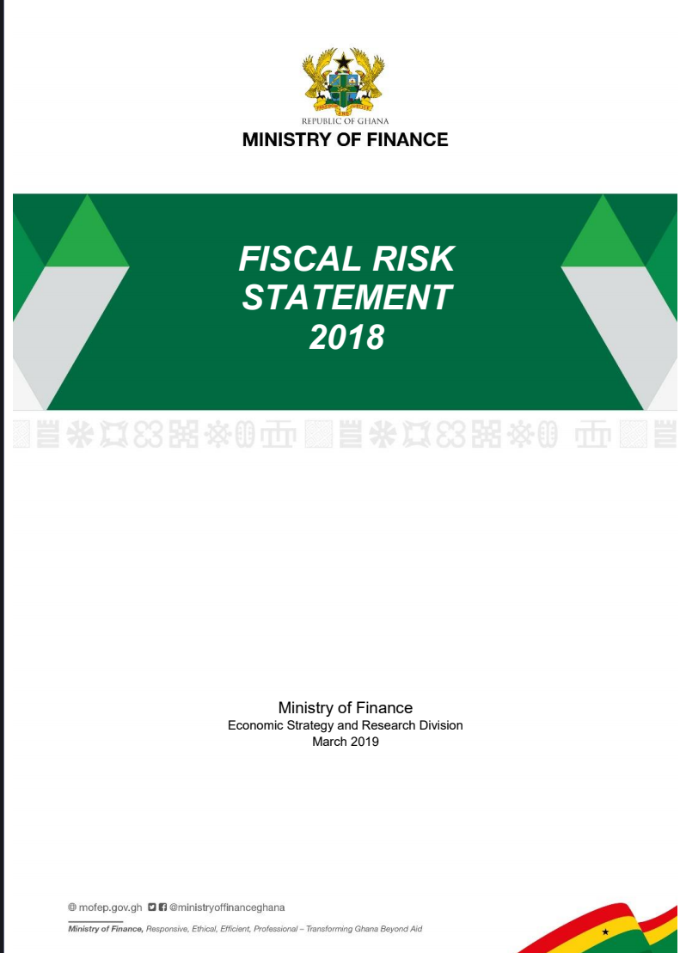
Framework for Fiscal Risk Management (Republic of Ghana)
Fiscal Risks that are being analyzed and reported in Ghana
GIFMIS
1. Promote efficiency, transparency and accountability in public financial management
through rationalization and modernization of budgeting and public expenditure
management of the Government of Ghana (GoG).
2. Promote the timely dissemination of information for financial management.
3. Rationalize the financial Administrative Decree and Regulations.
4. Improve the efficiency and effectiveness of revenue collection.
5. Maximize payment and commitment control.
6. To enhance controlling and monitoring of budgets at central and local government levels
7. Promote the timely dissemination of information for effective decision making within
governmental units
8. Standardization of accounting processes and procedures within MDAs and MMDAs
9. Promote efficiency, effectiveness, accountability and transparency in public financial
administration and management based on integrated nature of GIFMIS.
10. To promote implementation of the requirements of Financial Administration Act and
Financial Administration Regulation.
11. Enhance accuracy and reliability of financial information churned out by MDAs and
MMDAs.
MACROECONOMIC RISKS
Macroeconomic Performance
Macroeconomic Sensitivity Analysis
Sources of Macroeconomic Risk
Measures to Mitigate Macroeconomic Risks
PUBLIC DEBT RISKS
Size and Composition of Public Debt
Debt Sustainability Analysis
Key Debt Portfolio Risks Indicators
Strategies to Mitigate Public Debt Risks
STATE-OWNED ENTERPRISES RISKS
SOEs Financial Soundness Indicators
Main Fiscal Risks from SOEs
Measures to Mitigate Fiscal Risks from SOEs
FINANCIAL SECTOR RISKS
Overview of the Financial Sector
Risks and Stress Testing of the banking sector
Measures to mitigate the Banking Sector Risks
Microfinance institutions and Key Risks
OTHER FISCAL RISKS
Public Private Partnerships
Local Government
Pensions Scheme
Natural Disasters
Institutional risks

Slide 30
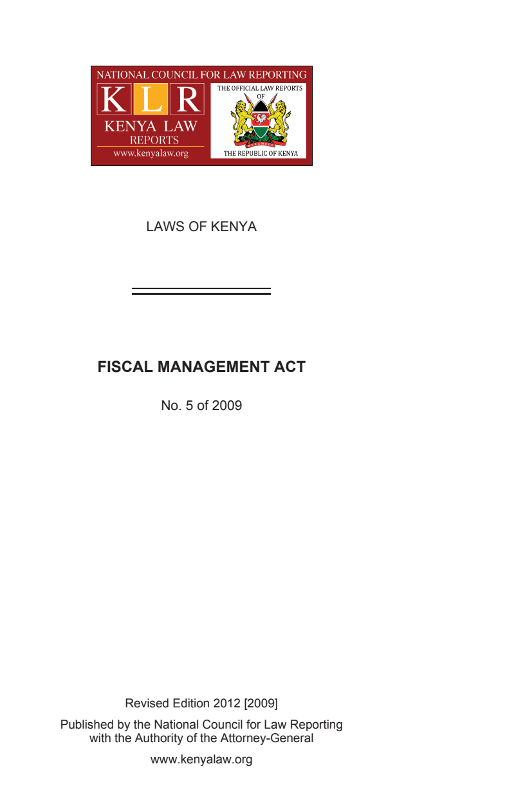
Legal Framework for Fiscal Risk Management (Republic of Kenya)
Fiscal Management Act 2009
borrowing policy that ensures that public debt is sustainable;
Requirement for fiscal policy that will achieve and maintain an adequate buffer of the State’s total net worth in the future;
minimization of fiscal risk to the State in respect of guaranteed loans, pension obligations and pending bills;
Monthly publication of revenues - Within twenty-one days after the end of each month
the macroeconomic and fiscal policies for a specified
targets for overall revenues, total aggregate expenditure and domestic and external borrowing for the succeeding financial year and the medium term;
an assessment of the current financial year and the projected state of the economy for the succeeding three years;
Fiscal Management Act 2009
  the estimates of interest and debt servicing charges and loan repayments for the financial year to which the budget relates and the next two financial years;
  indication of the intention regarding borrowing and actions that may increase public debt for the financial year;
  forecast financial position for the financial year to which the budget relates and the next two financial years;
  statement of specific fiscal risks and contingent liabilities including guaranteed loans, pending bills, uninsured risks, promissory notes and other internationally accepted instruments, as at the day on which the forecast financial statement are published and the rules that determine what constitutes current and future fiscal risks;
Fiscal Management Act 2009

Slide 31
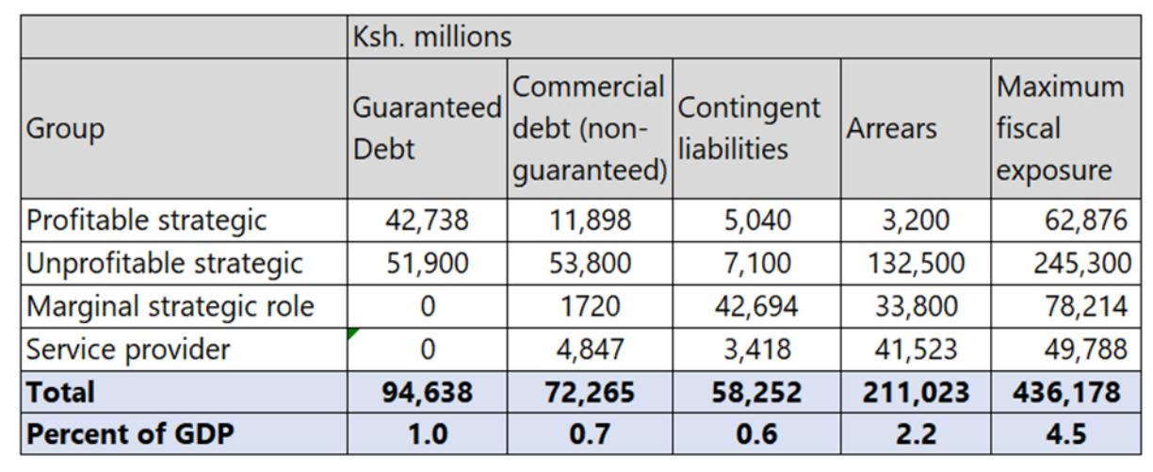
Framework for Fiscal Risk Management (Republic of Kenya)
The National Treasury identify and quantifying the fiscal risks arising from the State Corporations (SC) Sector to determine the amount of fiscal exposure from the SC sector, which can migrate to the national budget and negatively impact the economy
Table 4
The key fiscal risks to Government of Kenya are define in 3 areas as follows:
  Expenditure and revenue risk from unforeseen developments such as higher operating expenses or lower sales that reduce the net profit or increase losses.
  Liquidity risks and arrears accumulation, which are a consequence of adverse revenue and expenditure developments and uncompensated public service obligations where entities are unable to raise revenues or recover costs. These may result in a call on Government – in case the SC fails to have sufficient working capital – to finance short-term obligations, whereby debts continue to accumulate, become uncollectible, or are written off.
  3. Direct and contingent liabilities of which the Government may have an explicit legal obligation (such as a loan, guarantee, or contractual obligation as part of an investment project) or an implicit obligation, such as supporting an SC facing liquidity problems, given the strategic importance that it plays in the economy.
Estimated total fiscal exposure of the 18 major SCs FY2019-20 (Ksh. Millions)
Mitigation Measures
  reform measures to boost revenues and rationalize spending;
  new concessional borrowing;
  deferred repayments for on-lent loans;
  debt to equity swap;
  some combination of these measures.

Slide 32
Legal Framework for Fiscal Risk Management
(Uganda)
The Ministry of Finance, Planning and Economic Development (MoFPED) sets out the main fiscal risks that the government of Uganda faced
Public Finance Management Act, 2015 Amended Public Finance Management
Statutory Instruments Supplement 17 Gazette No. 43, 2016
(Amendment) Act, 2021
Mandate fiscal risk statement in the budget framework
shall have a statement of the main sources of risk to the fiscal objectives of Government and qualified estimation of the fiscal impact of these risks including the following:
(a) an alternate fiscal framework based on realistic assumptions of key macroeconomic variables;
(b) a statement of the individual sources of fiscal risks such as loans, guarantees, public private partnership arrangements, natural disasters or other contingent liabilities and an estimate of the likely fiscal impact of risks if they materialise;
(c) the risks in public debt management, including the results of the annual debt sustainability analysis; (d) the institutional risks, such as data quality and capacity constraints; and
(e) the risks from narrow or volatile revenue sources including natural resources and donor grants. (f) The fiscal risks statement shall specify the strategy to be used to manage the fiscal risks.
(g) The fiscal risks statement shall, where possible, estimate the quantitative impact of the identified risks on the macroeconomic framework and the Annual Budget.

Slide 33
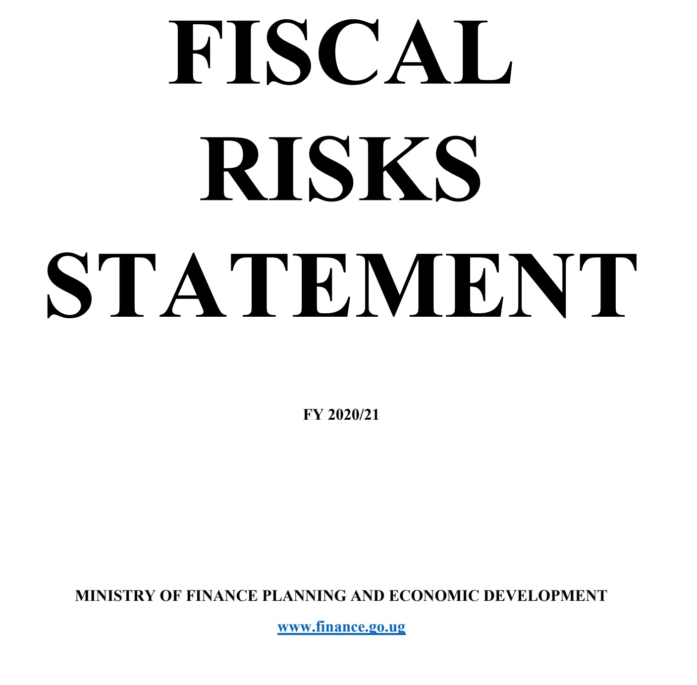
Framework for Fiscal Risk Management
(Uganda)
The Ministry of Finance, Planning and Economic Development (MoFPED) sets out the main fiscal risks that the government of Uganda faced.
Fiscal risks that are analyzed in Uganda Fiscal statement are:
MACROECONOMIC RISKS AND BUDGET SENSITIVITY
  External risks
  Forecast Performance and Analysis
  Overall balance
  Nominal Gross Domestic Product
  Revenue
  Expenditure
  Debt forecast Performance
  Budget Sensitivity
SPECIFIC AND STRUCTURAL RISKS
  Public debt
  Contingent Liabilities
  Loan guarantees
  Debt of Public Corporations
  Public-private Partnerships
  Mitigation measures for contingent liabilities
  Natural disasters
  Legal Claims
  Pension Liabilities
INSTITUTIONAL RISKS

Slide 34
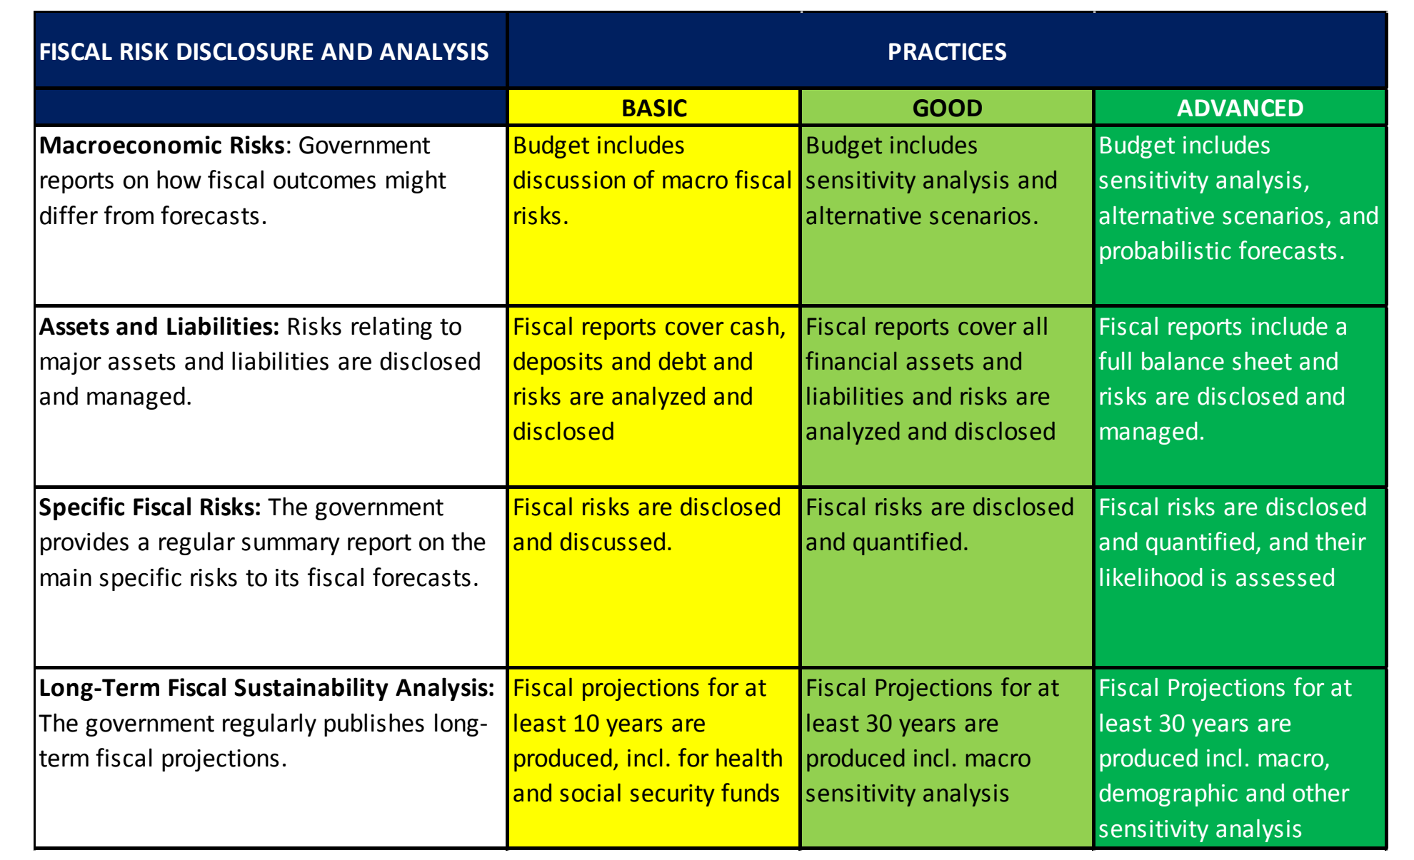
Recommendation : IMF Fiscal Transparency Code is key
Table 5

Slide 35
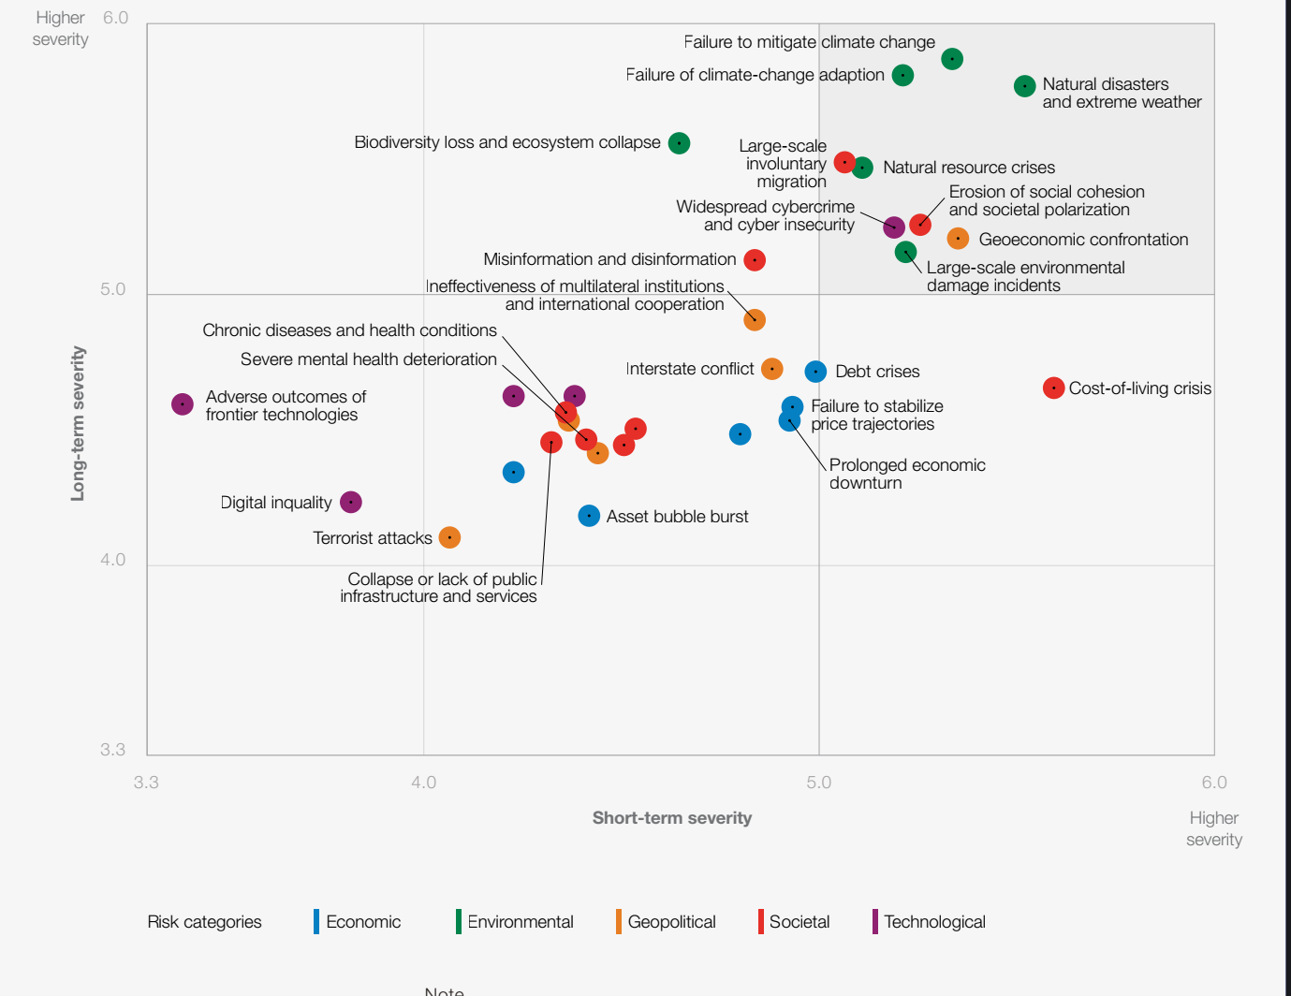
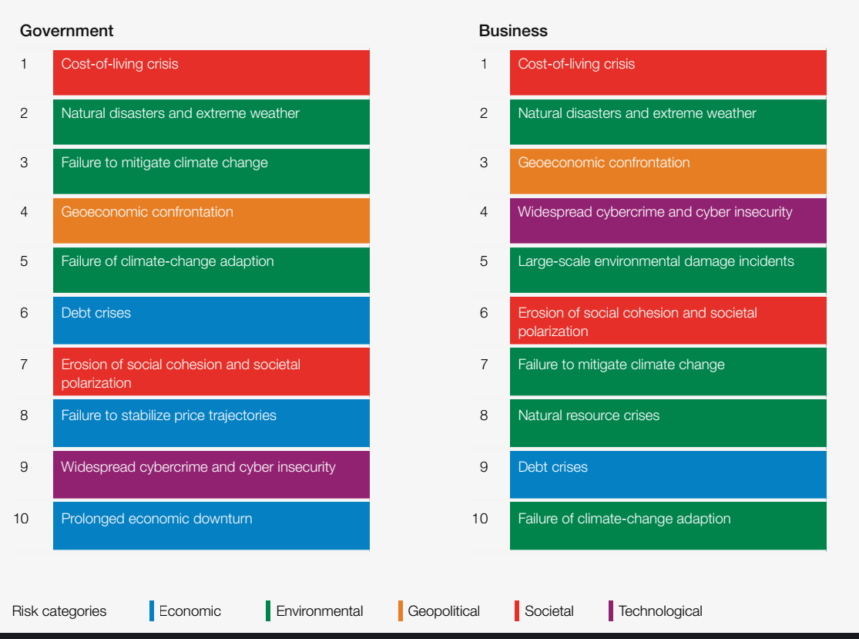
Some Challenges
The complex and rapid evolution of the global risks landscape is adding to a sense of unease.
Figure 7
Relative severity of risks over a 2 and 10-year period
Table 6
Global risks ranked by severity over the short term (2 years)
Source:
World Economic Forum Global Risks
Perception Survey 2022-2023.

Slide 36
Challenges
Adherence to the Laws: fiscal discipline is weak and remains a concern;
Absence of an overarching and coordinated PFM strategy in some countries;
Capacity and skill gaps in Fiscal risk management strategy development to comprehensively record and monitor fiscal risks and;
Inadequate ICT infrastructure in the public sector to support rollout of computerized platforms for effective records of contingent liabilities and other fiscal risks variables;
Sub-National Governments: in some cases, there is lack of comprehensive information on the financial condition and performance of sub-national governments individually and as a consolidate sector;
• Public Corporations: Many governments don't regularly publish comprehensive information on the financial performance of public corporations, including any quasi-fiscal activity
Global landscape is dominated by manifesting risk and other external shocks.

Slide 37
Conclusion Recommendation
While ongoing shocks unfold, the Africa stands at a crossroads. As we enter a low-growth, low-investment and low-cooperation era, countries need to :
Establish clear accountability for monitoring, managing and reporting contingent liabilities;
Ensure a monitoring mechanism for regular review of: (i) the potential for risk realization as new information becomes available; (ii) whether existing policies remain appropriate; and (iii) whether existing mitigation measures are adequate;
Establish intra-governmental coordination mechanisms to assess and monitor risks and policy responses, particularly between finance and economic ministries and central banks to monitor and manage financial sector exposures;
Parliamentary involvement in monitoring the guarantees given and called as well as the impact on the economy and employment of support measures will help provide additional legitimacy;
Ensure the full disclosure of all fiscal measures, be they direct or contingent, on-budget or off-budget;
Enhance capacity to mitigate and manage risks. The need for training and retraining on the World Bank Fiscal Risk Assessment (FRA)framework, and the IMF Fiscal rule toolkit
Better integrate fiscal risk analysis into fiscal policymaking : fiscal frameworks could be strengthened, together with the analysis and understanding of these risks and the reporting of Contingent Liabilities.

Slide 38
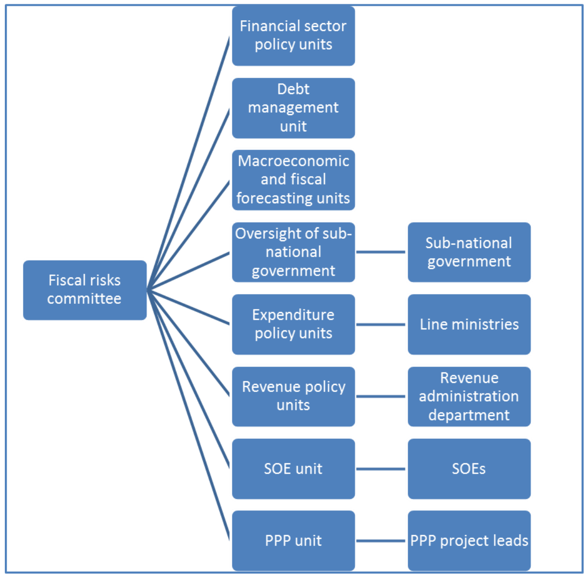
Conclusion Recommendation
Better integrate fiscal risk analysis into fiscal policymaking : fiscal frameworks could be strengthened, together with the analysis and understanding of these risks and the reporting of Contingent Liabilities.

Slide 39

End of Presentation
Thank you.
bmusa@waifem-cbp.org
baba.musa@aol.com

